Slide 1
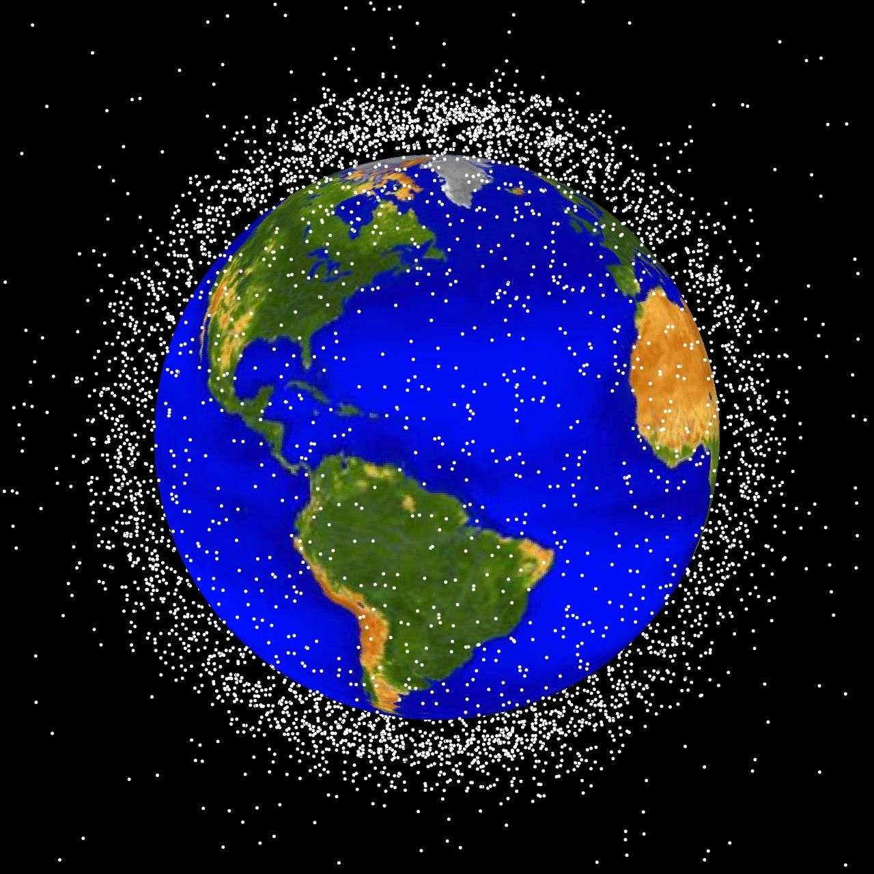
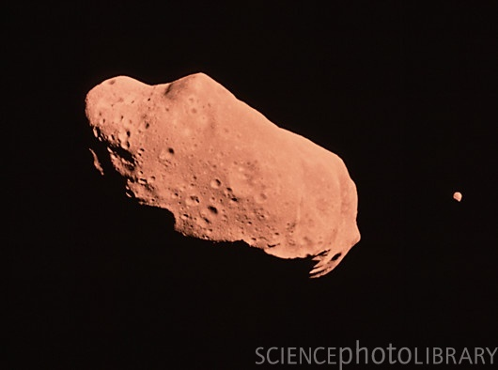
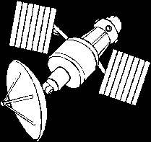
Near Earth Space Objects
STEM Tour
September 18,2024
Nahum Melamed
The Aerospace Corporation

Slide 2
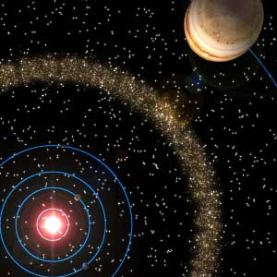
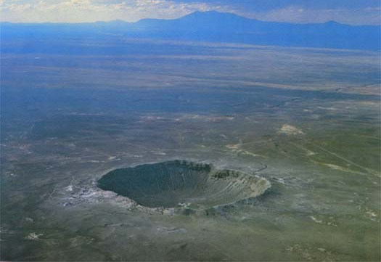
Asteroids and Comets
http://www.semp.us/publications/biot_reader.php?BiotID=443

Slide 3
Origin of
Asteroids

Slide 4
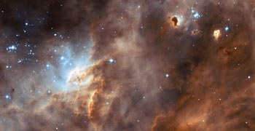
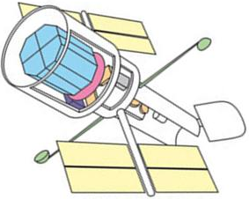
Star-forming Cloud, Hubble, 2003
Hubble Space Telescope
http://web.eps.utk.edu/~faculty/tennmaps/lectures/TennMaps_HistoryOfEarth.ppt
http://michaelgr.com/2007/05/20/the-hubble-space-telescope-vs-new-james-webb-space-telescope/

Slide 5
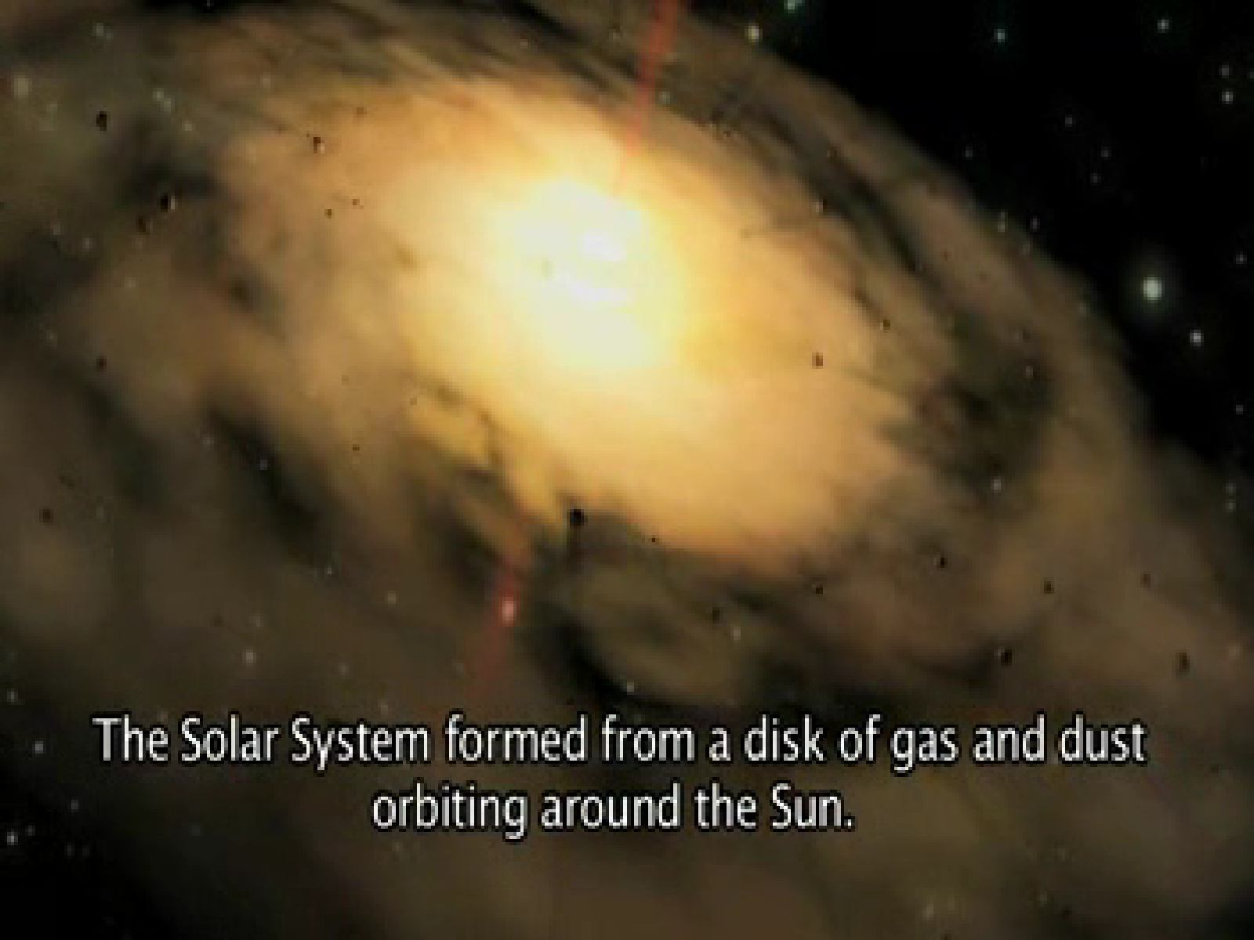

The Formation of the Solar System
Antonella Barucci, PDC 2013

Slide 6
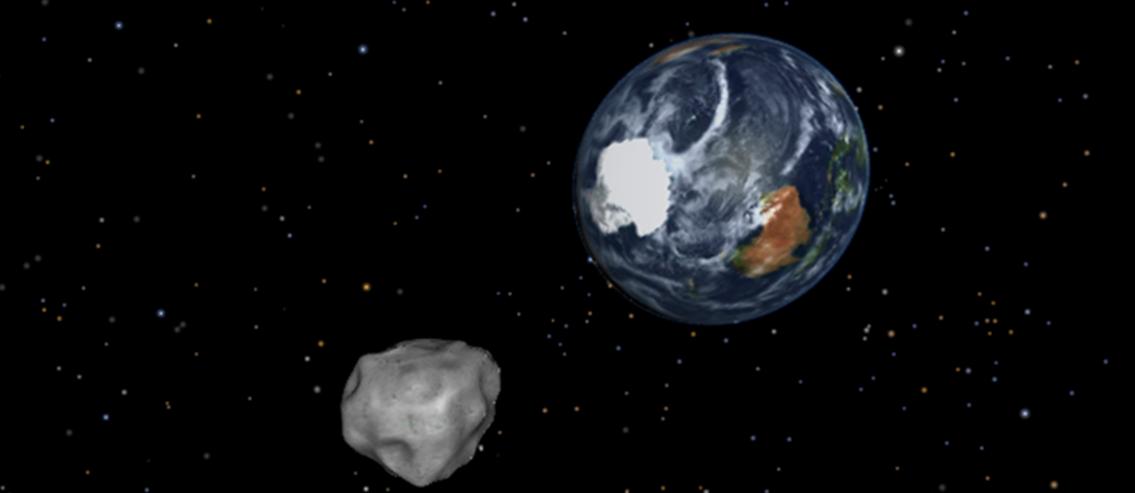
Near Earth Objects (NEOs)
https://www.nasa.gov/mission_pages/asteroids/news/asteroid20130204.html

Slide 7
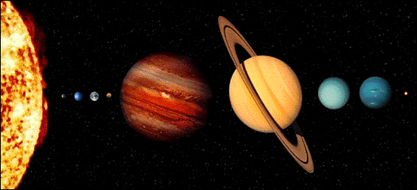
Name the Planets
http://coolcosmos.ipac.caltech.edu/cosmic_kids/learn_sirtf/dwarf.html
Notes:
http://pds.jpl.nasa.gov/planets/welcome.htm

Slide 8
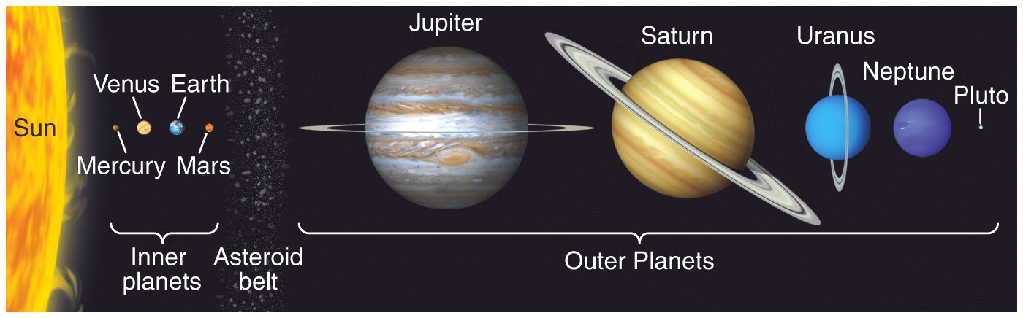
Planets’ Names and Sizes
Asteroid Belt
http://web.eps.utk.edu/~faculty/tennmaps/lectures/TennMaps_HistoryOfEarth.ppt

Slide 9

Asteroid Ida and Its Tiny Moon Dactyl
Taken by the imaging system on the Galileo spacecraft, 1993
Asteroid:
About 56 x 24 x 21 kilometers (35 x 15 x 13 miles)
Moon:
About 1.2 by 1.4 by 1.6 km (0.75 by 0.87 by 1 mile)
http://www.sciencephoto.com/images/download_lo_res.html?id=823100036
http://www.solarviews.com/eng/ida.htm

Slide 10

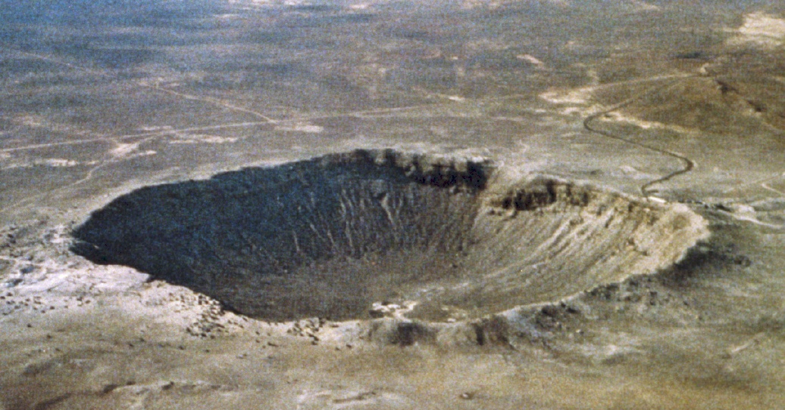
Meteor Crater, Arizona
Asteroid size = 3 School buses
Crater size = 85 School buses
http://solarsystem.nasa.gov/multimedia/gallery/Meteor_Crater.jpg

Slide 11
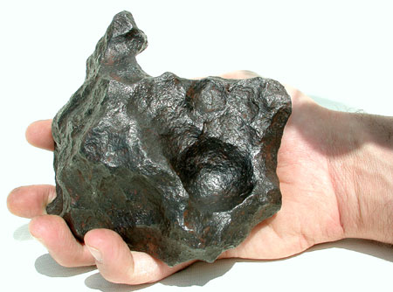
How Old is the Earth?
The Earth is ~4,570,000,000 years old
http://web.eps.utk.edu/~faculty/tennmaps/lectures/TennMaps_HistoryOfEarth.ppt

Slide 12

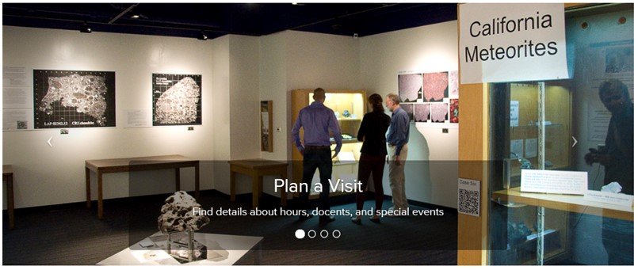
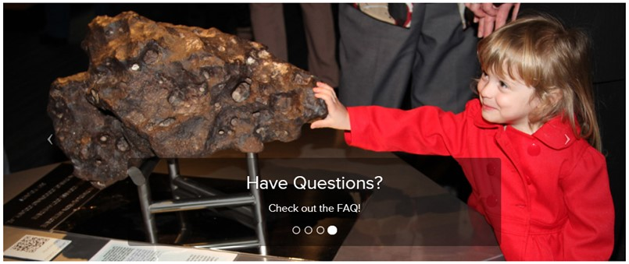
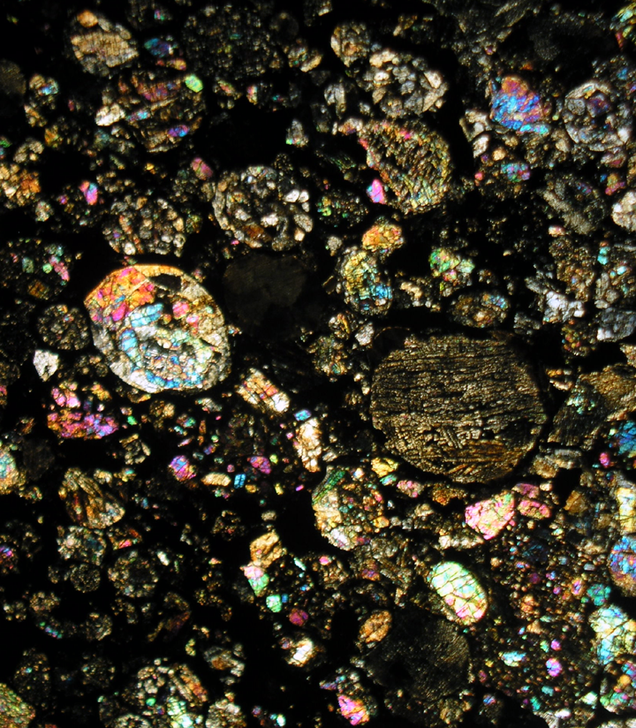
Meteorite Characterization
Meteorite Gallery
http://www.meteorites.ucla.edu/
Image credits: Alan Rubin, UCLA
Notes:
How to Tell the Size of an Asteroid
This chart illustrates how infrared is used to more accurately determine an asteroid's size. As the top of the chart shows, three asteroids of different sizes can look similar when viewed in visible-light. This is because visible-light from the sun reflects off the surface of the rocks. The more reflective, or shiny, the object is (a feature called albedo), the more light it will reflect. Darker objects reflect little sunlight, so to a telescope from millions of miles away, a large dark asteroid can appear the same as a small, light one. In other words, the brightness of an asteroid viewed in visible light is the result of both its albedo and size.
The bottom half of the chart illustrates what an infrared telescope would see when viewing the same three asteroids. Because infrared detectors sense the heat of an object, which is more directly related to its size, the larger rock appears brighter. In this case, the brightness of the object is not strongly affected by its albedo, or how bright or dark its surface is. When visible and infrared measurements are combined, the albedos of asteroids can be more accurately calculated.
Infrared Telescopes Spy Small, Dark Asteroids
This chart illustrates why infrared-sensing telescopes are more suited to finding small, dark asteroids than telescopes that detect visible light. The top of the chart shows how three asteroids of the same size but differing compositions would appear in visible light. An asteroid that has a shinier surface, or higher albedo, will appear brighter than a dark asteroid, even though they are the same size. This is because a shinier asteroid will reflect more visible light from the sun.
The bottom of the chart shows the same three asteroids when viewed in infrared light. They appear to be the same brightness, regardless of their albedo. Objects of the same size will radiate about the same amount of infrared light, as result of being heated by the sun. It's easier for an infrared telescope to see a small, dark asteroid because it senses the object's heat signature and not the little amounts of reflected sunlight.

Slide 13
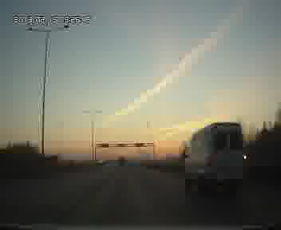
Meteorite Explosion - Russia Chelyabinsk 15 Feb 2013
http://www.youtube.com/watch?v=V-0w3FPkXds

Slide 14
Discovery of
Asteroids

Slide 15
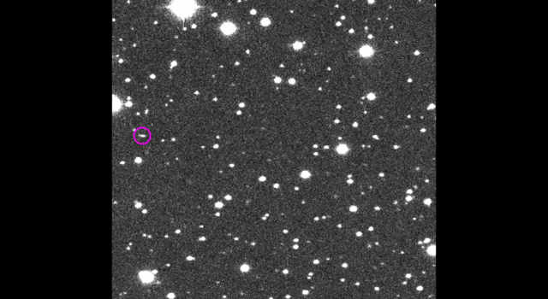
How a Speck of Light Became Asteroid 2014 AA
https://www.jpl.nasa.gov/spaceimages/details.php?id=PIA21712
Image credits:
NASA/JPL

Slide 16
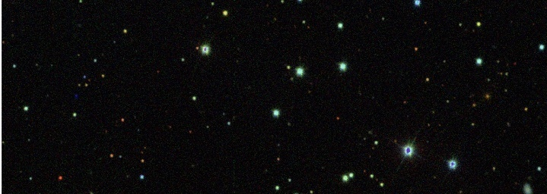
Discovery of Asteroid 2006 SQ372
http://www.astronomy.ohio-state.edu/~dhw/SDSS08/sq372_discovery_anim.gif

Slide 17
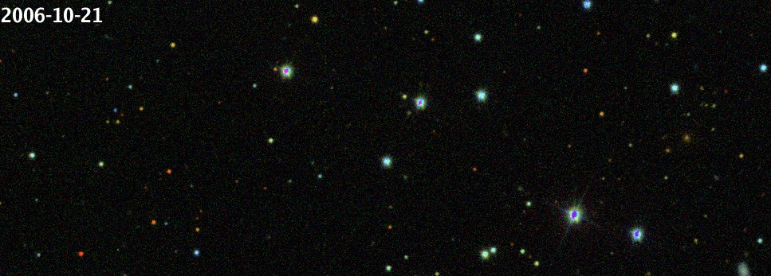
Discovery of Asteroid 2006 SQ372
An ice-rock minor planet 30 to 60 miles in diameter, discovered in 2006 between the orbits of Uranus and Neptune

Slide 18
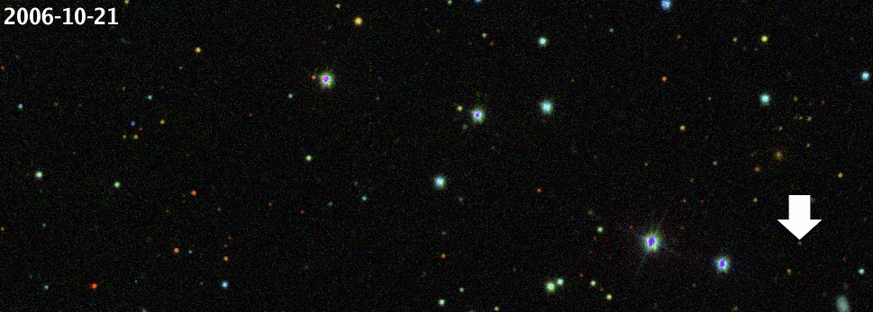
Discovery of Asteroid 2006 SQ372

Slide 19
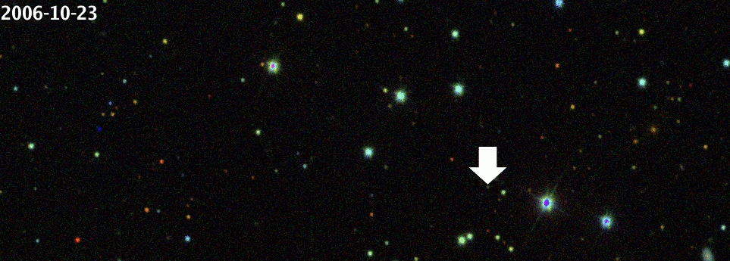
Discovery of Asteroid 2006 SQ372

Slide 20
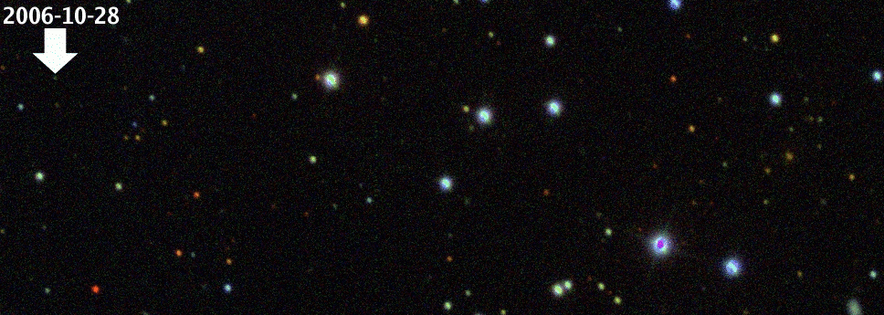
Discovery of Asteroid 2006 SQ372

Slide 21
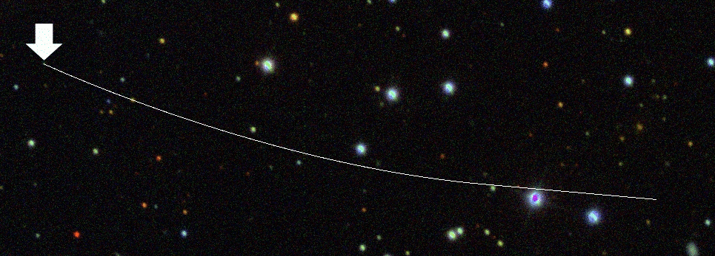
Discovery of Asteroid 2006 SQ372
The orbit of the asteroid can be determined

Slide 22
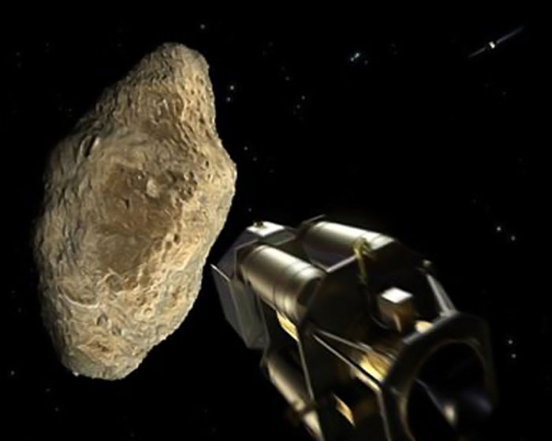
Kinetic Impact
Heavy spacecraft Collide with the asteroid and deflect it
http://spacefellowship.com/news/art23176/how-to-deflect-an-asteroid-with-today-s-technology.html

Slide 23

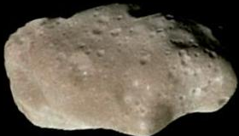
Incoming Asteroid
http://www.nasa.gov/mission_pages/dawn/mission/index.html
http://neo.jpl.nasa.gov/images/ida.html
http://visibleearth.nasa.gov/view.php?id=57723

Slide 24
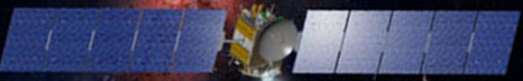
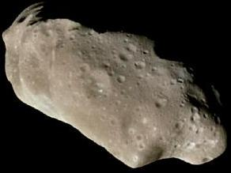
Deflect the asteroid and prevent collision with Earth
http://www.nasa.gov/mission_pages/dawn/mission/index.html
http://neo.jpl.nasa.gov/images/ida.html
http://visibleearth.nasa.gov/view.php?id=57723

Slide 25
In Conclusion
Be Prepared!
http://www.informationweek.com/news/infrastructure/showArticle.jhtml?articleID=165701019

Slide 26
Your Mission
Do well in School !!
You can be a scientist or an aerospace engineer

Slide 27
Thank You!

